Slide 1
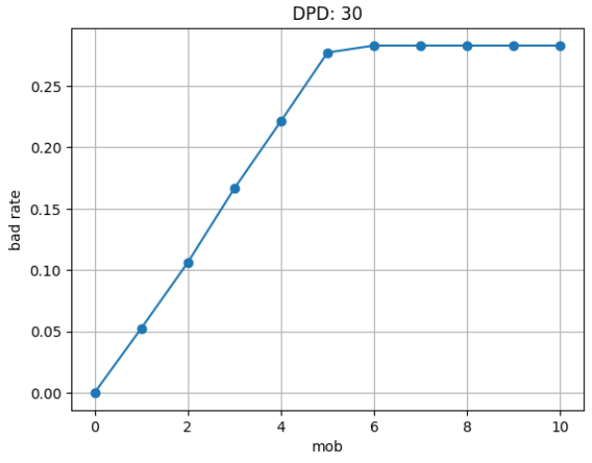
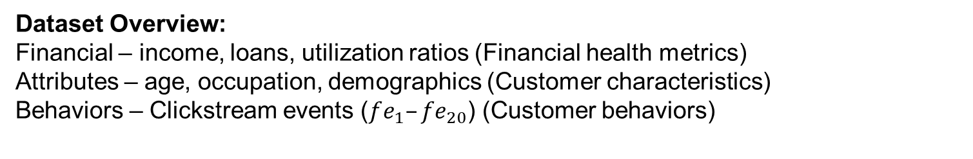
OVERVIEW
Predicting Loan Default Risk using Medallion Data Pipeline
CS6111 ; Assignment 1
Lim Kai Zhuo ; kz.lim.2023@mitb.smu.edu.sg
1
Objective: Build a data pipeline to train, tune, evaluate, and deploy a model to estimate customer default probability based on financial, attributes, and behaviors (FAB).
Given customer FAB before loan given: to predict and identify high-risk borrowers to enable loan rejection, proactive intervention, and credit optimization.
2
Approach: Implement a full Medallion architecture (Bronze → Silver → Gold) in PySpark in a Docker environment.
LABELS
FEATURES
Data Source for Label: Installment date, overdue amount
Labelling of Customer Default: Rather than waiting for customer to default, use days past due to estimate
Days Past Due(DPD) Calculation: Each snapshot ➔ If customer has overdue ➔ Subtract snapshot date from first overdue date
Default Labelling: If DPD > 30 ➔ Label as default
Threshold DPD of 30: Selected as threshold as the bad rate plateaus afterwards
Dataset Overview:
Financial – income, loans, utilization ratios (Financial health metrics)
Attributes – age, occupation, demographics (Customer characteristics)
Behaviors – Clickstream events ($fe_{1}–fe_{20}$) (Customer behaviors)
Bronze Overview: Extract raw data from backend data source
Silver Overview : Data cleaning of raw Bronze data
Numerical: Outliers handling, null/ placeholder coercion, string to float/int cleaning
Categorical: Regular expression cleaning, binning, binary/indicator variables
(e.g. Type of loan split into 1 column for 0/1 for each loan type)
Imputation: Missing values fill with mean of group (e.g. NA salary filled with avg. of job)
Gold Overview : Feature Engineering to create new features that are either simpler, new insights, or introduces non-linearities (esp. useful for linear models)
Preventing Data Leakage: To prevent data leakage, during training, use X(t-6),y(t) as features and labels. By joining features from a snapshot date 6 months prior to the labels snapshot date, this ensure there is no possible temporal data leakage. Imagine as using all possible information at snapshot t-6 months to predict customer default at snapshot t months
Ratio Metrics: Taking ratios of variables of absolute monetary values into new scale-independent financial ratios. E.g. Debt-to-income, Dept-per-loan, EMI-to-income
Non-linear Transformations: Log, squared, cubed
Threshold / Binning: Simplify continuous variables into bins or ordinal categories
Data Source
Bronze
Silver
Gold
Environment & Operations: Running in a docker container. Entire data pipeline is in a single main.py file that can be scheduled to run automatically using airflow.
Financials
Image of raw data from backend data source
Data Cleaning
Interaction Variables
Attributes
3
Conclusion: Medallion architecture setup to provide a clean dataset with feature engineering to train, tune, evaluate, and deploy predictive model.
Next Action: Train various models (linear regression / XGB), perform feature selection, hyperparameter tuning, to select best model to deploy
Missing Value Imputation
Non-linear Transformation
Clickstream
Categorical Variables
Binning / Indicators
Loan Data

Slide 2
Bronze Layer
Predicting Loan Default Risk using Medallion Data Pipeline
1
Objective: Bronze Layer – Data Ingestion and Standardization:
Raw data ingestion to consolidate source files for downstream cleaning (silver) and feature engineering (gold).
Captures data exactly as received, unmodified, and traceable
Ensures full auditability and reproducibility
Data Source
csv files
Bronze: datamart/bronze/
csv files
Financials
Features/features_financials/
Attributes
Features/features_attributes/
2
Method: Data Source (csv files) ➔ Bronze Datamart (csv files)
Raw data ingestion to consolidate source files from data source to bronze datamart
Append vs Overwrite table
Clickstream
Features/features_clickstream/
Loan Data
lms/
Append Table (clickstream): New data appended as new rows to the table
Load source file
spark.read.csv(…)
Filter by snapshot date
.filter(col('snapshot_date') == snapshot_date)
Save to Bronze Datamart
spark.toPandas.to_csv(…)
Overwrite Table (financials & attributes): If customer exists, overwrite existing row
Load source file
spark.read.csv(…)
Filter by snapshot date
.filter(col('snapshot_date’) <= snapshot_date)
Save to Bronze Datamart
spark.toPandas.to_csv(…)
3
Key Considerations:
Partitioning by snapshot date for efficient time-based queries
Standardization of datamart into separate tables (folders) for the 3 types of features and 1 label table
Append vs Overwrite table.
  Since overwrite table will have 1 row per customer_ID only, when filtering by snapshot date, we must keep the previous entries with older snapshot_date to ensure all existing customer data are captured
  For append table, each snapshot adds new roles for existing customers in the same snapshot_date, hence we can filter by snapshot_date exactly

Slide 3
Silver Layer
Predicting Loan Default Risk using Medallion Data Pipeline
1
Objective: Silver Layer – Data Cleaning:
Transforms raw Bronze data into clean, consistent, and analysis-ready datasets
Remove noise and inconsistencies from raw inputs.
Ensure column-level data validity and completeness.
Create one cleaned dataset per source type (financial, clickstream, attributes).
Bronze: datamart/bronze/
csv files
Silver: datamart/silver/
parquet files
Features/features_financials/
Features/features_financials/
Features/features_attributes/
Features/features_attributes/
Features/features_clickstream/
Features/features_clickstream/
2
Method: Bronze Datamart (csv files) ➔ Silver Datamart (parquet files). 1 Folder per Table
lms/
lms/
Numerical
Outlier floor and ceil to bounded values (e.g. age)
String to value (e.g. credit history age Years and Months ➔ months as int)
Schema Enforcement
Null / Placeholder / Invalid Characters
Categorical
Binary/Nominal variables (e.g. spend level low/med/high ➔ 0/1/2)
Explode groups into individual indicator variable (loan type can have 1 or more groups in the same string ➔ convert to 1 column per loan type with 0 or 1 value)
Enforce correct datatypes for each columns
(e.g. float, int, str, date)
Strip leading and trailing unwanted characters
Replace default values and missing with standardized placeholder values
String to numeric
Imputations
Missing values impute with default 0 values
OR impute with average by group (e.g. missing salary impute with occupation mean)
3
Key Considerations:
Validity checks: regular expression and trimming to handle incorrect input values
Missing values and imputations: proper default values handling and imputation to ensure no missing data
Outlier treatment: ensure no extreme values
Categorical variables: proper handling of indicator/binary variable to ensure downstream models can use such data (e.g. linear regression must have 1 hot encoding for nominal categorical variables rather than integer values)

Slide 4

Gold Layer
Predicting Loan Default Risk using Medallion Data Pipeline
1
Silver: datamart/silver/
parquet files
Gold: datamart/gold/
Gold_model: datamart/gold/
Objective: Gold Layer – Feature Engineering and Model Preparation:
Gold layer combines all Silver tables into a unified, model-ready feature store
Merge financial, behavioral, and demographic features for each customer
Engineer features to enable better model training and performance
Store final dataset in a consistent schema for model training and inference.
Features/features_financials/
LR_v1/
Features/features_attributes/
Feature_store/
Features/features_clickstream/
XGB_v1/
2
Method: Silver Datamart (parquet files) ➔ Gold Datamart (parquet files)
Firstly, join all features in silver layer by customer and snapshot date into 1 table.
Then perform feature engineering
lms/
$$…$$
Ratio Metrics
Non-linear Transformations
Model-Specific Gold Tables
Taking ratios of variables
Financial meaningful ratios to help prediction
Introduces non-linearity, useful for linear models and XGB
E.g. Debt-to-income, Dept-per-loan
Log scale: helps with values with long tail distribution (e.g. income, debt)
Square/cube: helps emphasis risk is non-linearly worse for higher debt values
Introduces non-linearity (similar to ratio metrics)
Prepare features by selecting subset for specific model training
E.g. XGB can use larger number of features and even categorical features (without one-hot encoding)
But linear regression need to select and prepare features that are compatible with linear models
E.g. remove perfect multi-collinearity columns (or highly correlated columns)
Create 1 gold_model table for each model
Additionally, after training an intital model with a lot of features, based on features importance (e.g. SHAP or high L1 regularization term), we can identify a subset of features to use for the next V2 iteration of the model and so on
Threshold / Binning
Simplify continuous variables into small number of bins (e.g. age bin to 0,1,2)
Add threshold to flag out (indicator) based on financial knowledge. E.g. Debt to income ratio exceed certain threshold value
3
Key Considerations:
Joining of features from various silver tables into single gold table
Engineer features to simplify, enhance, and introduce non-linearity ➔ At this stage, more is better, can use feature importance to subset later on
Prepare model-specific gold tables as each model has different needs.

Slide 5
Model Training
Predicting Loan Default Risk using Medallion Data Pipeline
1
Objective: Combine Features and Labels for Model Training
Load gold model feature table and gold label table for model training
Gold_model: datamart/gold/
LR_v1/
2
Method: Gold Datamart (parquet files) – Features (t-6), Labels (t)
Select the desired gold model feature table based on the model being trained
Perform join on gold label table
To prevent temporal data leakage, join on feature tables with a snapshot date 6 months prior.
Since the feature table contains all information up to time t-6 and this is used to predict the label table with information at time t ➔ this ensures there is no possible temporal data leakage from features to labels
Snapshot: t-6 months
Model
Train / Tune / Evaluate
label_store/
Snapshot: t
3
Key Considerations:
Selecting the correct gold model feature table for the desired model
Prevent data leakage by joining features table from 6 months before labels table

